Slide 1
Sparse & Redundant Representations and Their Applications in Signal and Image Processing CS Course 236862 – Winter 2015/6
Michael Elad
The Computer Science Department
The Technion – Israel Institute of technology
Haifa 32000, Israel
October, 2015

Slide 2
What This Field is all About ?
Depends whom you ask, as the researchers in this field come from various disciplines:
Mathematics
Applied Mathematics
Statistics
Signal & Image Processing: CS, EE, Bio-medical, …
Computer-Science Theory
Machine-Learning
Physics (optics)
Geo-Physics
Astronomy
Psychology (neuroscience)
…

Slide 3
My Answer (For Now)
A New Transform for Signals
We are all well-aware of the idea of transforming a signal and changing its representation.
We apply a transform to gain something – efficiency, simplicity of the subsequent processing, speed, …
There is a new transform in town, based on sparse and redundant representations.

Slide 4
Transforms – The General Picture
n
Invertible Transforms
n
Linear
n
Separable
Structured
Unitary

Slide 5
Redundancy?
In a redundant transform, the representation vector is longer (m>n).
This can still be done while preserving the linearity of the transform:
m
n
n
n
m

Slide 6
Sparse & Redundant Representation
m
We shall keep the linearity of the inverse-transform.
As for the forward (computing α from x), there are infinitely many possible solutions.
We shall seek the sparsest of all solutions – the one with the fewest non-zeros.
This makes the forward transform a highly non-linear operation.
The field of sparse and redundant representations is all about defining clearly this transform, solving various theoretical and numerical issues related to it, and showing how to use it in practice.
n
n
Sounds … Boring !!!! Who cares about a new transform?

Slide 7
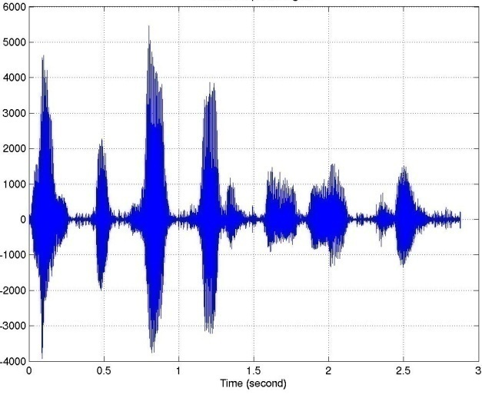
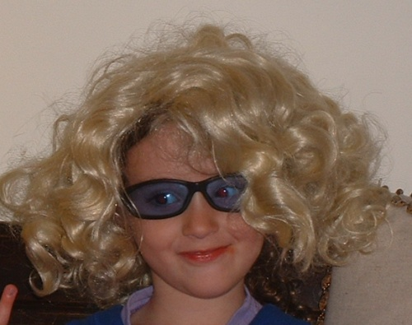

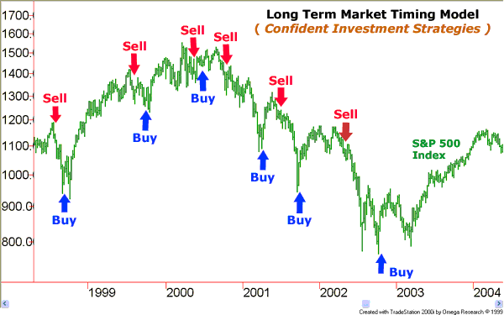
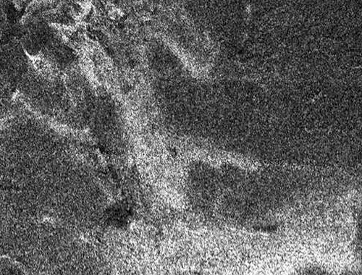
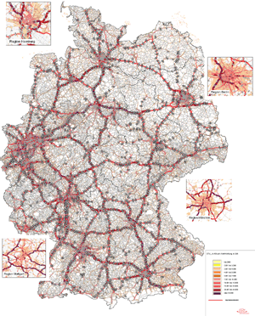
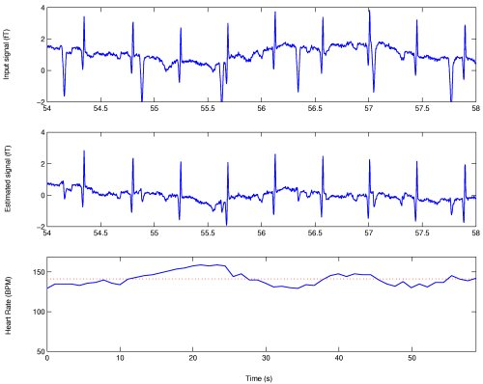
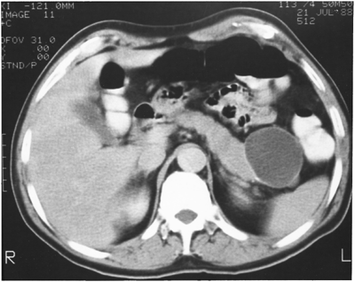
Lets Take a Wider Perspective
Stock Market
Heart Signal
Still Image
Voice Signal
Radar Imaging
Traffic Information
We are surrounded by various sources of massive information of different nature.
All these sources have some internal structure, which can be exploited.
CT

Slide 8
Model?
Effective removal of noise (and many other applications) relies on an proper modeling of the signal

Slide 9
Which Model to Choose?
There are many different ways to mathematically model signals and images with varying degrees of success.
The following is a partial list of such models (for images):
Good models should be simple while matching the signals:
Principal-Component-Analysis
Anisotropic diffusion
Markov Random Field
Wienner Filtering
DCT and JPEG
Wavelet & JPEG-2000
Piece-Wise-Smooth
C2-smoothness
Besov-Spaces
Total-Variation
Beltrami-Flow
Simplicity
Reliability

Slide 10
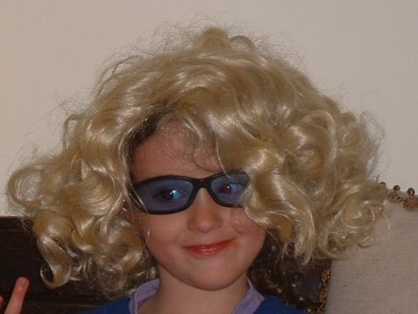

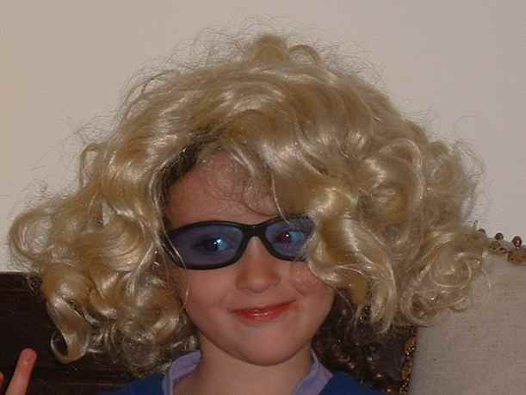
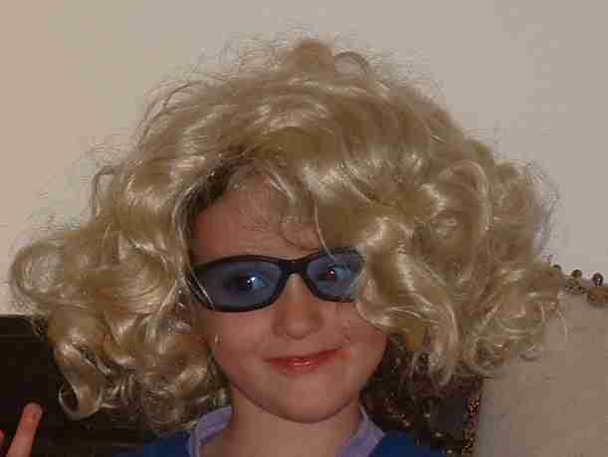
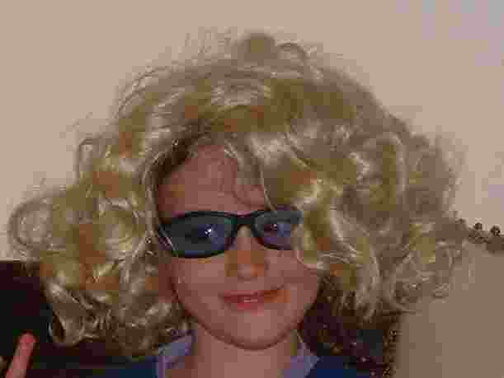


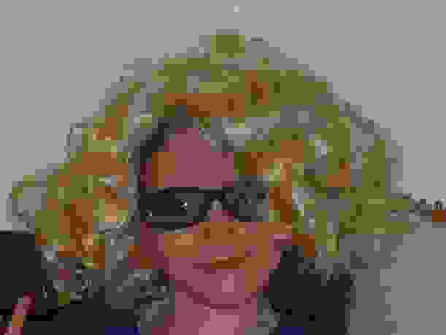
An Example: JPEG and DCT
178KB – Raw data
24KB
20KB
12KB
How & why does it works?
8KB
Discrete Cosine Trans.
4KB
The model assumption: after DCT, the top left coefficients to be dominant and the rest zeros.

Slide 11

Research in Signal/Image Processing
Problem (Application)
Model
Signal
Numerical Scheme
A New Research Work (and Paper) is Born
The fields of signal & image processing are essentially built of an evolution of models and ways to use them for various tasks

Slide 12
Again: What This Field is all About?
A Data Model and Its Use
Almost any task in data processing requires a model – true for denoising, deblurring, super-resolution, inpainting, compression, anomaly-detection, sampling, and more.
There is a new model in town – sparse and redundant representation – we will call it Sparseland.
We will be interested in a flexible model that can adjust to the signal.

Slide 13
A New Emerging Model
Mathematics
Signal Processing
Machine Learning
Wavelet Theory
Approximation Theory
Sparseland and Example-Based Models
Multi-Scale Analysis
Linear Algebra
Optimization Theory
Signal Transforms
Compression
Inpainting
Super-Resolution
Blind Source Separation
Denoising
Demosaicing

Slide 14

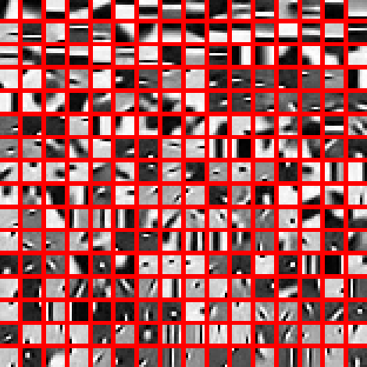
The Sparseland Model
Task: model image patches of size 10×10 pixels.
We assume that a dictionary of such image patches is given, containing 256 atom images.
The Sparseland model assumption: every image patch can be described as a linear combination of few atoms.
Σ
α₁
α₂
α₃

Slide 15

The Sparseland Model
Properties of this model: Sparsity and Redundancy.
Chemistry of Data
Σ
We start with a 10-by-10 pixels patch and represent it using 256 numbers – This is a redundant representation.
However, out of those 256 elements in the representation, only 3 are non-zeros – This is a sparse representation.
Bottom line in this case: 100 numbers representing the patch are replaced by 6 (3 for the indices of the non-zeros, and 3 for their entries).
α₁
α₂
α₃

Slide 16
Model vs. Transform ?
m
The relation between the signal x and its representation α is the following linear system, just as described earlier.
We shall be interested in seeking sparse solutions to this system when deploying the sparse and redundant representation model.
This is EXACTLY the transform we discussed earlier.
n
n
Bottom Line: The transform and the model we described above are the same thing, and their impact on signal/image processing is profound and worth studying.

Slide 17
Difficulties With Sparseland
Problem 1: Given an image patch, how can we find its atom decomposition ?
A simple example:
There are 2000 atoms in the dictionary
The signal is known to be built of 15 atoms
possibilities
If each of these takes 1nano-sec to test, this will take ~7.5e20 years to finish !!!!!!
Solution: Approximation algorithms
Σ
α₁
α₂
α₃

Slide 18
Difficulties With Sparseland
Various algorithms exist. Their theoretical analysis guarantees their success if the solution is sparse enough
Here is an example – the Iterative Reweighted LS:
Σ
α₁
α₂
α₃

Slide 19
Difficulties With Sparseland
Problem 2: Given a family of signals, how do we find the dictionary to represent it well?
Solution: Learn! Gather a large set of signals (many thousands), and find the dictionary that sparsifies them.
Such algorithms were developed in the past 5 years (e.g., K-SVD), and their performance is surprisingly good.
This is only the beginning of a new era in signal processing …
Σ
α₁
α₂
α₃

Slide 20
Difficulties With Sparseland
Problem 3: Is this model flexible enough to describe various sources? e.g., Is it good for images? Audio? Stocks? …
General answer: Yes, this model is extremely effective in representing various sources.
Theoretical answer: yet to be given.
Empirical answer: we will see in this course, several image processing applications, where this model leads to the best known results (benchmark tests).
Σ
α₁
α₂
α₃

Slide 21
Difficulties With Sparseland ?
Σ
Problem 1: Given an image patch, how can we find its atom decomposition ?
Problem 2: Given a family of signals, how do we find the dictionary to represent it well?
Problem 3: Is this model flexible enough to describe various sources? E.g., Is it good for images? audio? …
ALL ANSWERED POSITIVELY AND CONSTRUCTIVELY
α₁
α₂
α₃

Slide 22
This Course
Will review a decade of tremendous progress in the field of
Sparse and Redundant Representations
Numerical Problems
Applications (image processing)
Theory

Slide 23
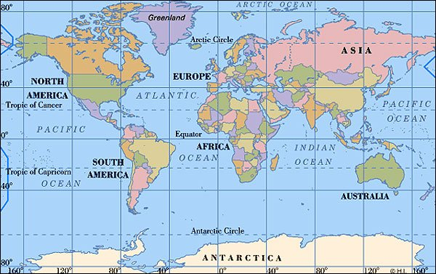





















Who is Working on This?
Donoho
Donoho, Candes – Stanford
Tropp – CalTech
Baraniuk, W. Yin – Rice Texas
Gilbert, Vershynin, Plan– U-Michigan
Gribonval, Fuchs – INRIA France
Starck – CEA – France
Vandergheynst – EPFL Swiss
Rao, Delgado – UC San-Diego
Do, Ma – U-Illinois
Davies – Edinbourgh UK
Elad, Zibulevsky, Bruckstein, Eldar, Segev, Beck, Mendelson – Technion
Goyal – MIT
Mallat – Ecole-Polytec. Paris
Nowak, Willet – Wisconsin
Coifman – Yale
Romberg – GaTech
Lustig, Wainwright – Berkeley
Sapiro, Daubachies – Duke
Friedlander – UBC Canada
Tarokh – Harvard
Cohen, Combettes – Paris VI

Slide 24
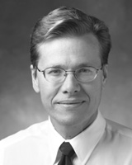

David L. Donoho
An extremely talented mathematician and statistician from the Stanford Statistics Department.
He is among the few who founded this field sparse and redundant representations and its spin-off topic of compressed sensing.
In 2013 he won the Shaw prize (“the Nobel of the east”).

Slide 25
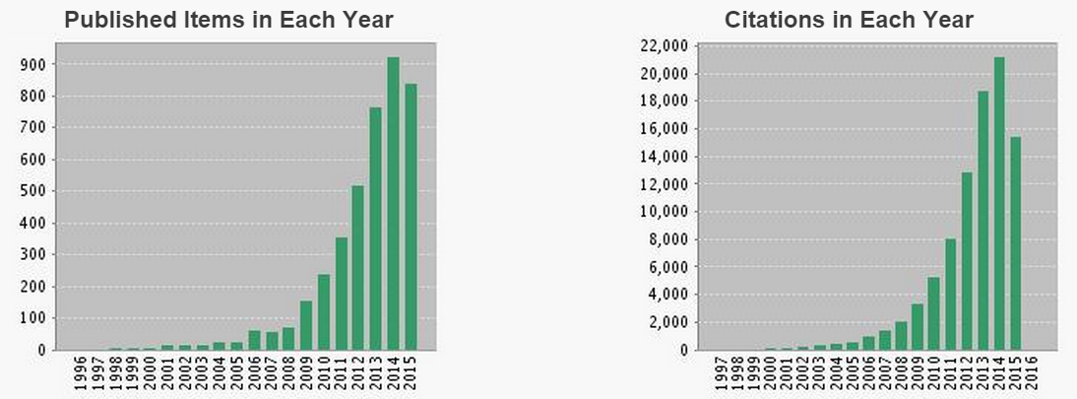
This Field is rapidly Growing …
Searching ISI-Web-of-Science (October 11th 2015):
Topic=((spars* and (represent* or approx* or solution)
and (dictionary or pursuit)) or
(compres* and sens* and spars*))
led to 3927 papers (it was ~3000 papers a year ago)
Here is how they spread over time (with ~92000 citations):

Slide 26
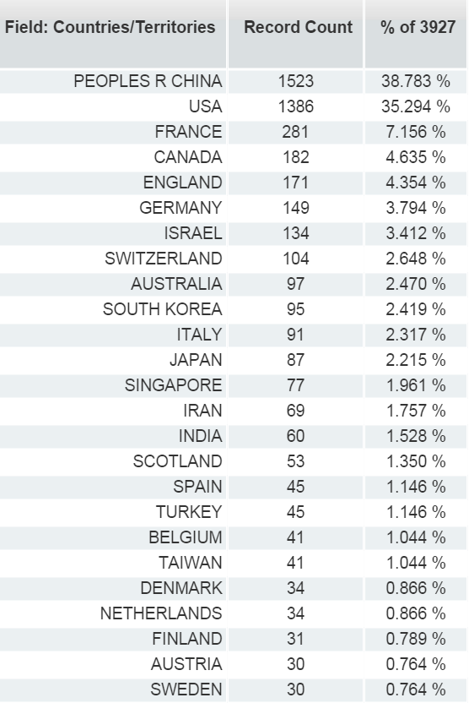
Which Countries?

Slide 27
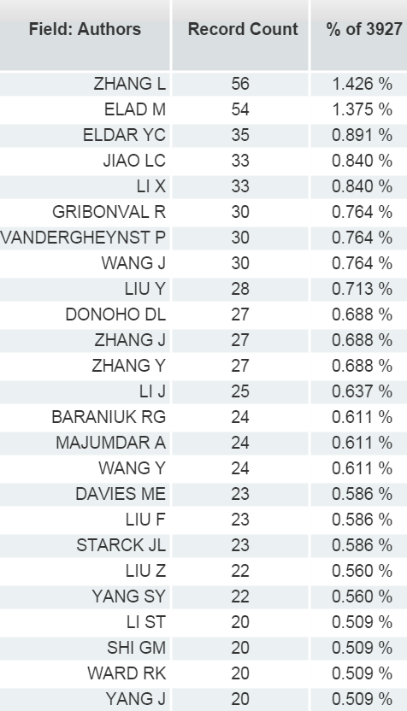
Who is Publishing in This Area?
# citations
709
7966
1685
156
188
844
636
--
--
13947
.
.
.
1140
.
.
.
.
1373
.
.
.
Zhang Lei – Xidian Radar
Zhang Lei – HK Polytech
Zhang Li – Xidian EE
Zhang Li – Tsinghua Univ.
Zhang Long – Xidian
Zhang Lan – Xi An Jiao Tong
Zhang Liang – Chongqing
Zhang Liao – Xidian
Zhang Lin – Beijing Univ.
Zhang Lu – Capital Med.

Slide 28
Here Are Few Examples for the Things That We Did With This Model So Far …

Slide 29




Image Separation [Starck, Elad, & Donoho (`04)]
The original image - Galaxy SBS 0335-052 as photographed by Gemini
The Cartoon part spanned by wavelets
The texture part spanned by global DCT
The residual being additive noise

Slide 30
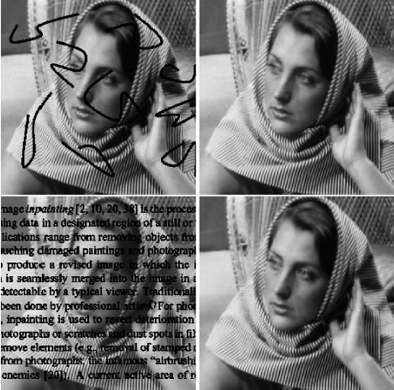
Inpainting [Starck, Elad, and Donoho (‘05)]
Source
Outcome

Slide 31
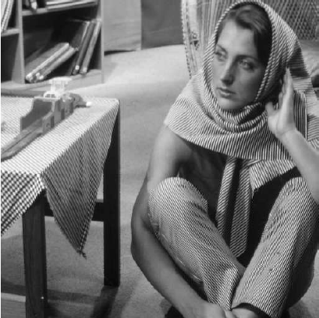


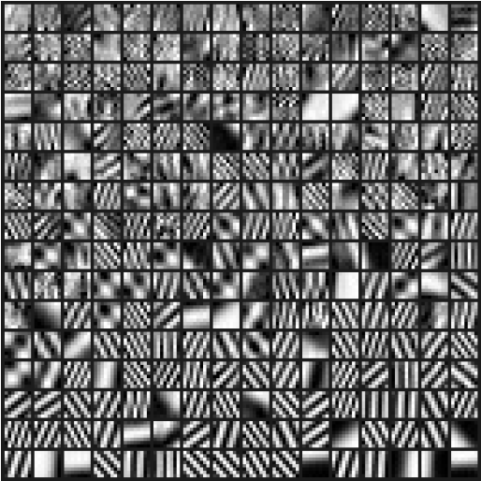

Image Denoising (Gray) [Elad & Aharon (`06)]
Source
Result 30.829dB
Noisy image
Initial dictionary (overcomplete DCT) 64×256
The obtained dictionary after 10 iterations

Slide 32
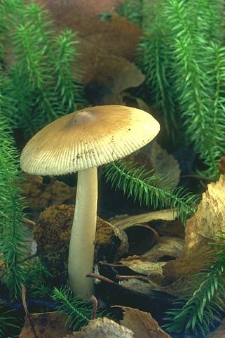
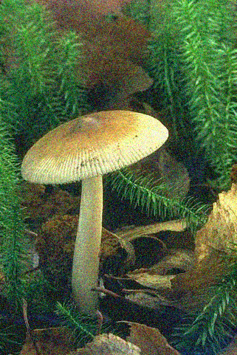

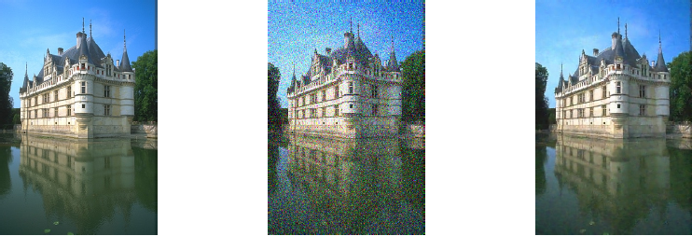
Denoising (Color) [Mairal, Elad & Sapiro, (‘06)]
Original Noisy (12.77dB) Result (29.87dB)
Original Noisy (20.43dB) Result (30.75dB)

Slide 33
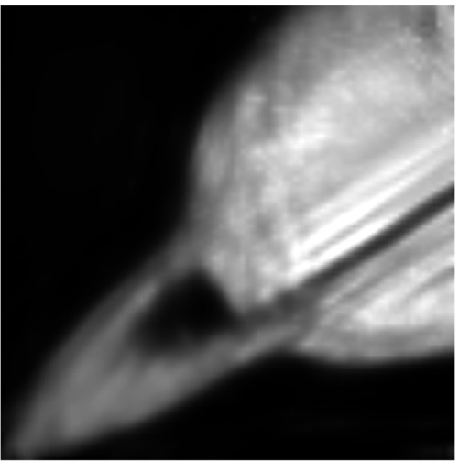
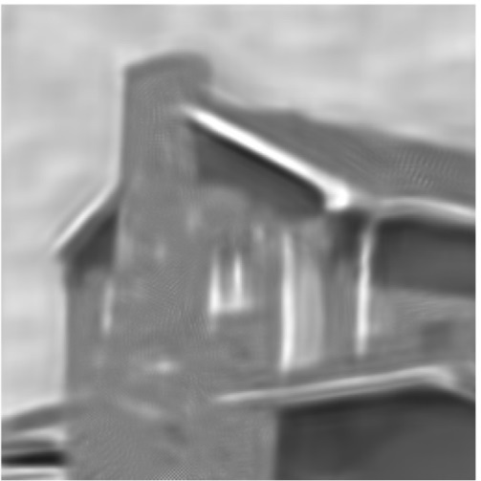
Poisson Denoising [Giryes & Elad (‘14)]
Original Noisy (peak=0.2) Result (PSNR=24.16dB)
Original Noisy (peak=2) Result (PSNR=24.76dB)

Slide 34
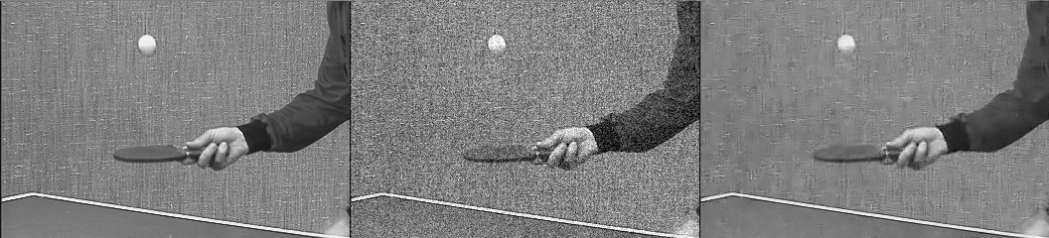
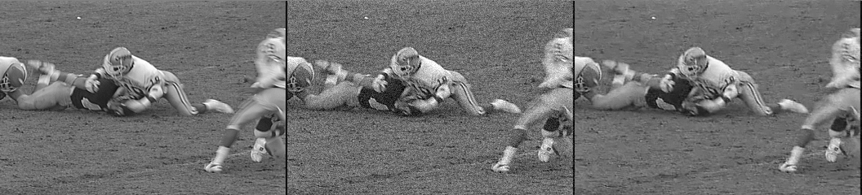
Video Denoising [Protter & E. (‘09)]
Original Noisy (σ=25) Denoised (PSNR=27.62)
Original Noisy (σ=15) Denoised (PSNR=29.98)

Slide 35
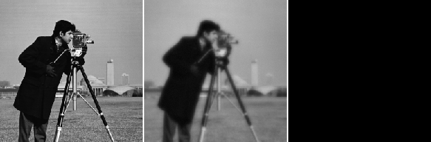
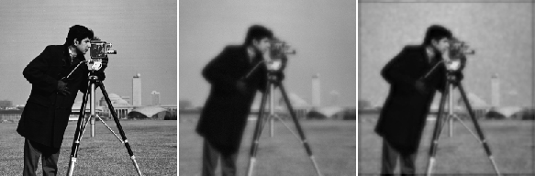
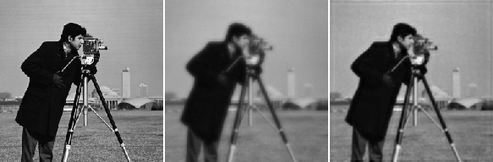

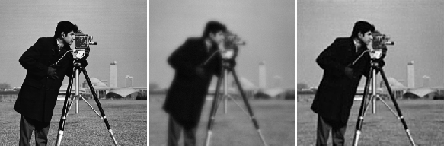




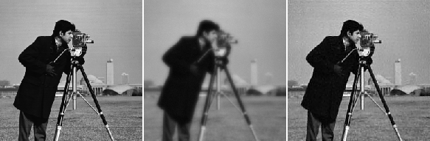

Deblurring [Elad, Zibulevsky and Matalon, (‘07)]
original (left), Measured (middle), and Restored (right): Iteration: 0 ISNR=-16.7728 dB
original (left), Measured (middle), and Restored (right): Iteration: 1 ISNR=0.069583 dB
original (left), Measured (middle), and Restored (right): Iteration: 2 ISNR=2.46924 dB
original (left), Measured (middle), and Restored (right): Iteration: 3 ISNR=4.1824 dB
original (left), Measured (middle), and Restored (right): Iteration: 4 ISNR=4.9726 dB
original (left), Measured (middle), and Restored (right): Iteration: 5 ISNR=5.5875 dB
original (left), Measured (middle), and Restored (right): Iteration: 6 ISNR=6.2188 dB
original (left), Measured (middle), and Restored (right): Iteration: 7 ISNR=6.6479 dB
original (left), Measured (middle), and Restored (right): Iteration: 8 ISNR=6.6789 dB
original (left), Measured (middle), and Restored (right): Iteration: 12 ISNR=6.9416 dB
original (left), Measured (middle), and Restored (right): Iteration: 19 ISNR=7.0322 dB

Slide 36
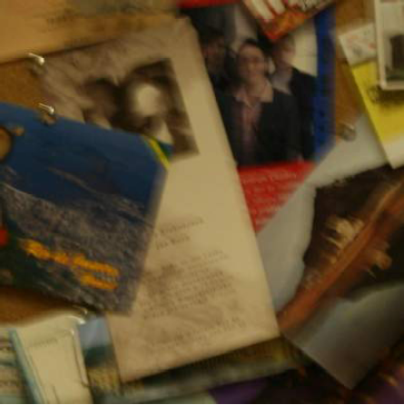
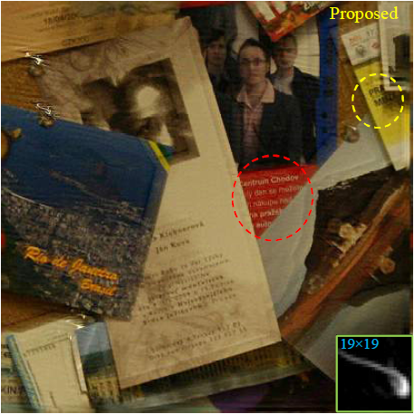
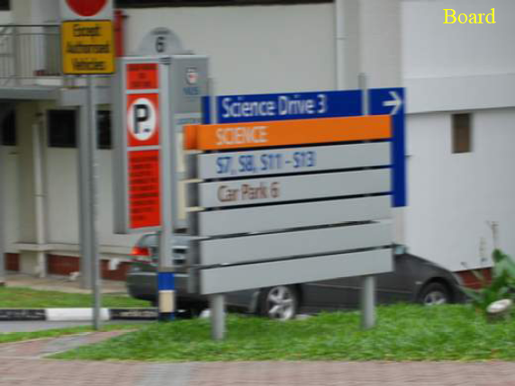
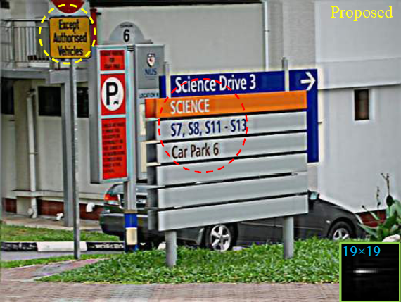
Blind Deblurring [Shao and Elad (‘14)]

Slide 37
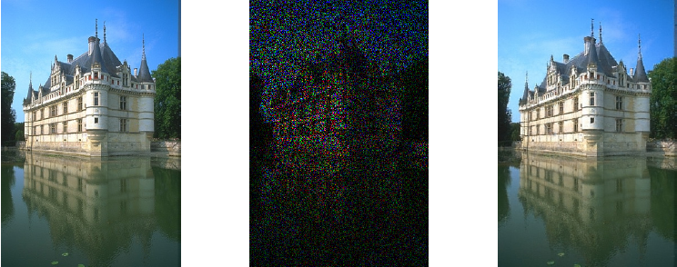
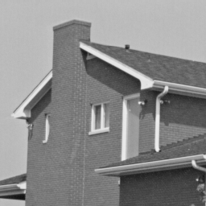


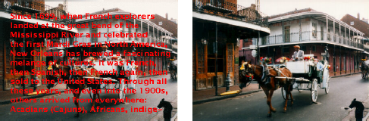
Inpainting (Again!) [Mairal, Elad & Sapiro, (‘06)]
Original 80% missing
Original 80% missing
Result
Result

Slide 38
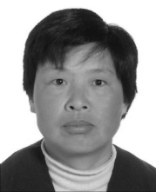
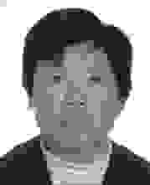


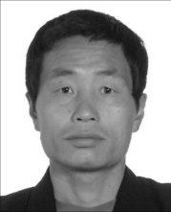
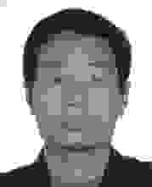


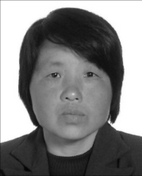

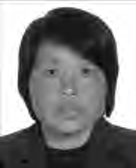

Facial Image Compression [Brytt and Elad (`07)]
15.81
13.89
6.60
Results for 550 Bytes per each file
14.67
12.41
5.49
15.30
12.57
6.36

Slide 39
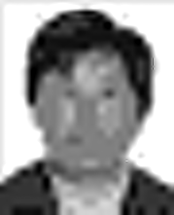

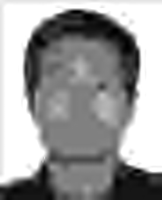



Facial Image Compression [Brytt and Elad (`07)]
?
18.62
7.61
?
Results for 400 Bytes per each file
16.12
6.31
?
16.81
7.20

Slide 40
Super-Resolution [Zeyde, Protter & Elad (‘09)]
Ideal Image
SR Result
PSNR=16.95dB
Bicubic interpolation PSNR=14.68dB
Given Image

Slide 41
Super-Resolution [Zeyde, Protter & Elad (‘09)]
The Original Bicubic Interpolation SR result

Slide 42
To Summarize
An effective (yet simple) model for signals/images is key in getting better algorithms for various applications
Sparse and redundant representations and other example-based modeling methods are drawing a considerable attention in recent years
Which model to choose?
Are they working well?
Yes, these methods have been deployed to a series of applications, leading to state-of-the-art results. In parallel, theoretical results provide the backbone for these algorithms’ stability and good-performance

Slide 43
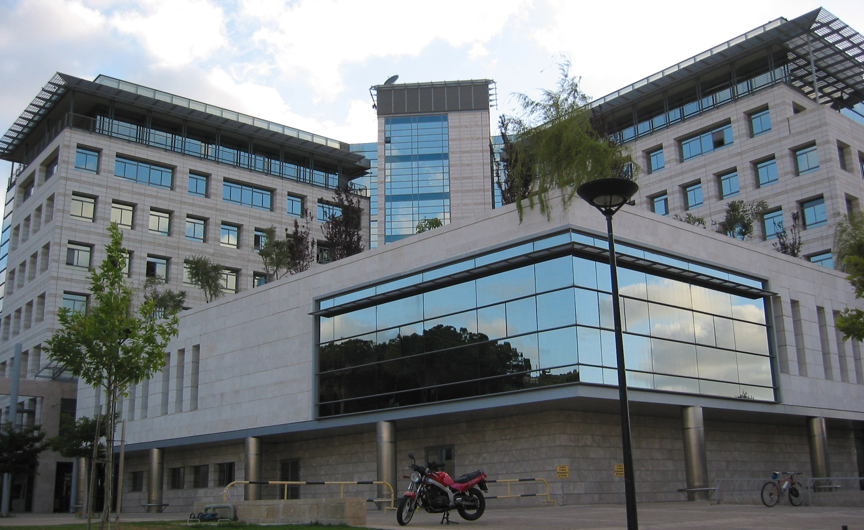
And now some Administrative issues …

Slide 44
This Course – General
Sparse and Redundant Representations and their Applications in Signal and Image Processing
Course #: 236862
Michael Elad | Lecturer
2 points | Credits
Sunday, Taub 5, 10:30-12:30 | Time and Place
Elementary image processing course: 236860 or 046200. Graduate students are not obliged to this requirement | Prerequisites
Recently published paper and the book that will be mentioned hereafter | Literature
http://www.cs.technion.ac.il/~elad/teaching and follow form there
Monday 25.01.2016 and MOED B: Friday 26.02.2015 | Exams

Slide 45

Course Material
We shall follow this book.
No need to buy the book. The lectures will be self-contained.
The material we will cover has appeared in 40-60 research papers that were published mostly (not all) in the past 8-9 years.

Slide 46

This Course Site
http://www.cs.technion.ac.il/~elad/teaching/courses/Sparse_Representations_Winter_2015/index.htm
Go to my home page, click the “teaching” tab,
then “courses”, and choose the top on the list

Slide 47
This Course – Lectures and HW
Lecture | Chapter | Topic
1 | 1 | General Introduction
2 | 2 | Uniqueness of sparse solutions
3 | 3 | Pursuit algorithms [HW1: Inpainting with Greedy Alg.]
4 | 4 | Pursuit Performance – Equivalence theorems
5 | 5 | Handling noise – uniqueness and equivalence
6 | 5 | Pursuit for the noisy case
7 | 5,6 | Stability, Iterative shrinkage [HW2: Iterative Shrinkage]
8 | 9,10 | The Sparseland model and its use – basics
9 | 11 | MMSE and MAP – an estimation point of view
10 | 12,13 | Dictionary learning, Face image compression
11 | 14 | Image denoising [HW3: Image Denoising via Signature DL]
12 | 14 | Image denoising and inpainting – recent methods
13 | 15 | Image separation, inpainting revisited, super-resolution

Slide 48
This Course - Grades
Course Requirements
The course has a regular format (the lecturer gives all talks).
There will be 3 (Matlab) HW assignments, to be submitted in pairs.
Pairs (or singles) are required to perform a project, which will be based on recently published 1-3 papers. The project will include
A final report (10-20 pages) summarizing these papers, their contributions, and your own findings (open questions, simulations, …).
A presentation of the project in a mini-workshop at the end of the semester.
The course includes a final exam with ~20 quick questions to assess your general knowledge of the course material.
Grading:
30% - home-work, 20% - project seminar, 20% - project report, and 30% - exam.
For those interested:
Free listeners are welcome.
Please send me (elad@cs.technion.ac.il) an email so that I add you to the course mailing list.

Slide 49
This Course - Projects
Read the instruction in the course’s site

Slide 50
Good Luck
I hope you will enjoy this course
and
have a great semester

